Slide 1
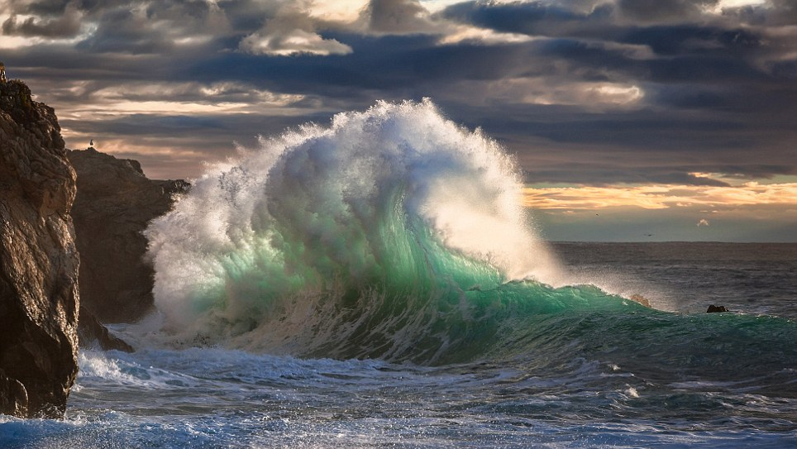
Marine Genomics
Welcome!

Slide 2
Introductions
~20 min
Survey

Slide 3
Syllabus
5-10 min

Slide 4
Internship
Work on data analyses for kelp and urchin datasets
California Conservation Genomics Project: project PI Rachael Bay
Current team: Serena Caplins (Postdoc), Vanessa Guerra (Postdoc), Rachael Bay (Associate Professor), Maddie Armstrong (PhD student), Josh Melendez (MS student CSULA)
+ 3 undergraduate students!
Part-time for 8 weeks = $15/hour for 160 hours ($2500).
Start Mid June – End of August
Participate in data analyses, figure generation, and statistical analyses, read scientific papers, and software documentation
Weekly team meetings
Notes:
https://www.ccgproject.org/p-project-pis

Slide 5

Internship Application: Due May 4th
Interns will be selected based on a one-page essay response to the following questions:
What skills/experiences do you hope to gain in this internship?
What skills that you’ve developed through course work or work experience, do you hope to bring to this internship?
What's the best team you’ve ever been a part of and why? (Describe what makes a good team)
Application form posted on Canvas!
Notes:
Emphasize that we are looking for someone who is organized, motivated, and a team player. Give examples of how they could describe course work or job experience for a successful internship application.

Slide 6

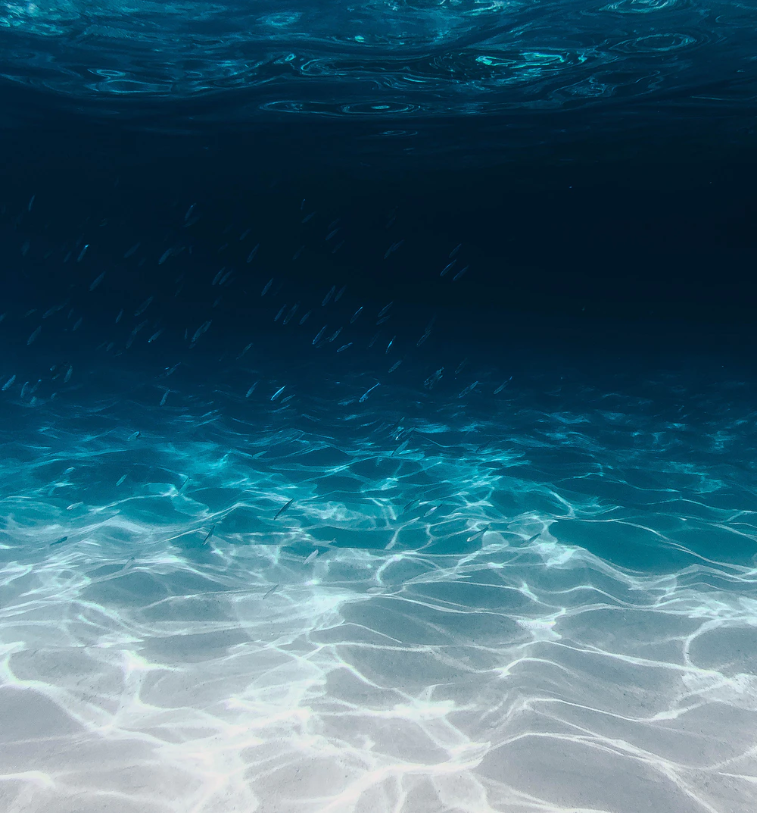
What is Marine Genomics?
Start Recording
Using genomic data to answer questions about the evolutionary biology of marine organisms.
Genotype
Seascape genomics
Ecological genomics
Environment
Phenotype
Figure modified from: https://link.springer.com/article/10.1007/s11295-013-0596-x
Notes:
Highlight that natural selection operates on phenotypes (whose expression is modulated by the environment) but that change over time (evolution) requires genetic variants to be associated with those phenotypes and to be passed down to offspring.

Slide 7
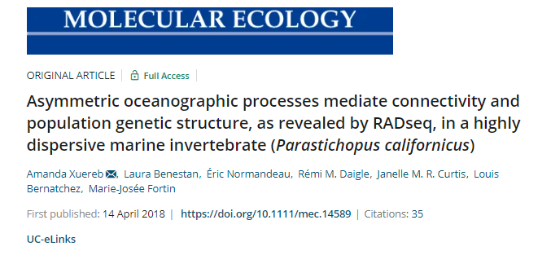
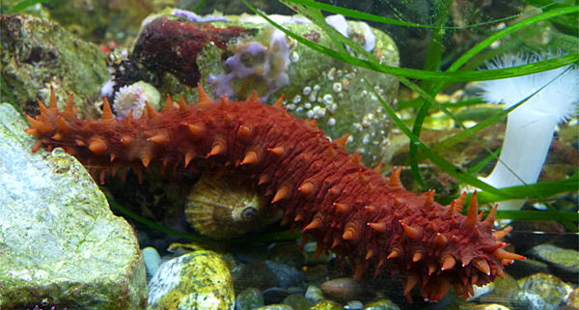
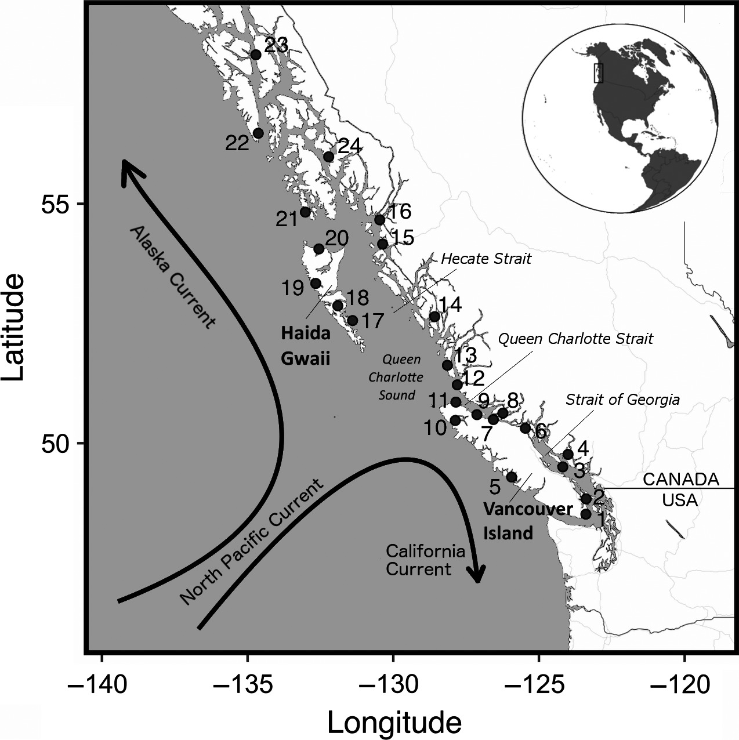
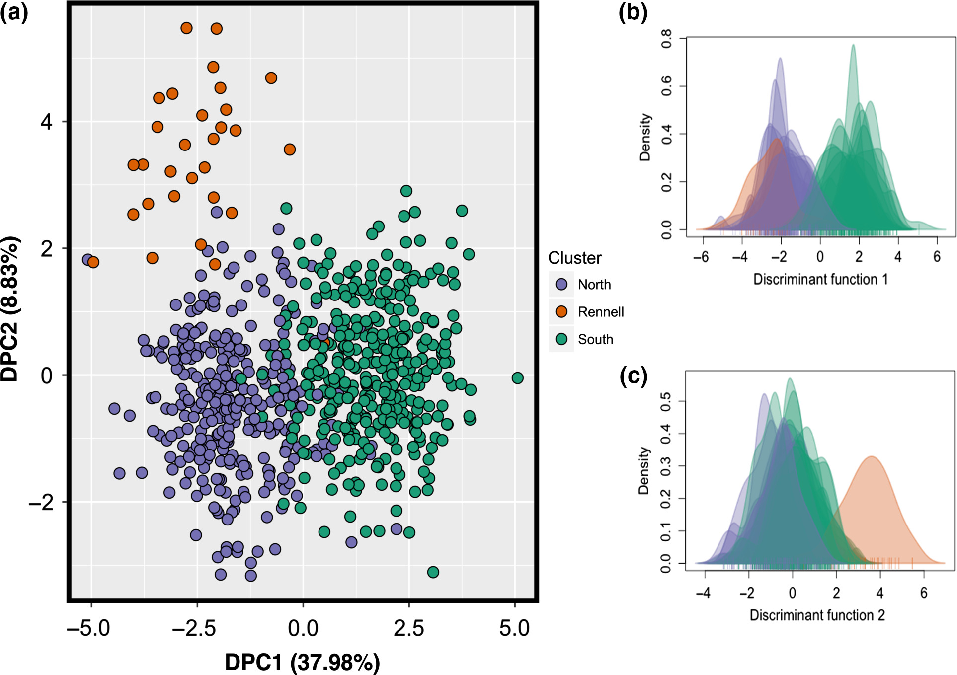
Notes:
Highlight genotype and environment interactions
http://www2.bio.ulaval.ca/louisbernatchez/pdf/(417)%20Xuereb_Molecular_Ecology_2018.pdf
https://pubmed.ncbi.nlm.nih.gov/29654703/

Slide 8
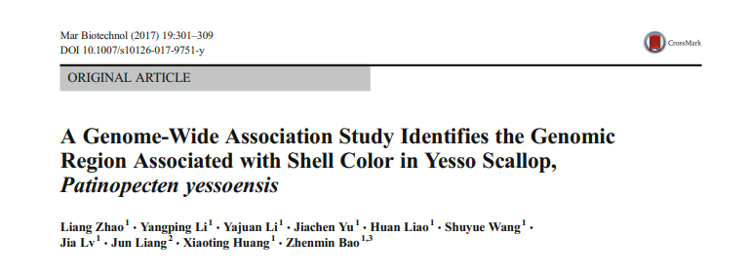
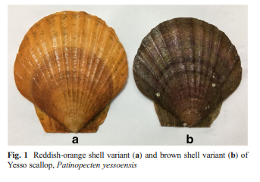
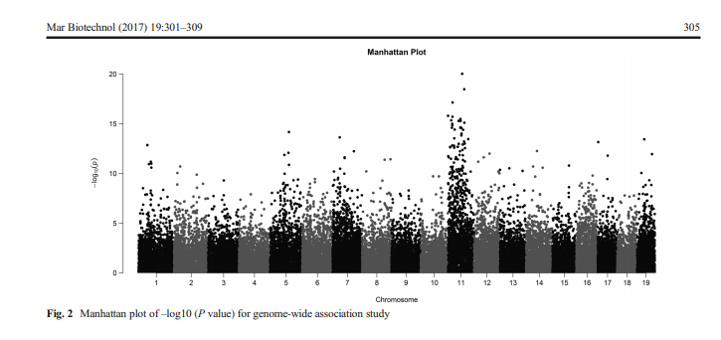
Notes:
https://link.springer.com/article/10.1007/s10126-017-9751-y#Bib1
Genotype and phenotype

Slide 9
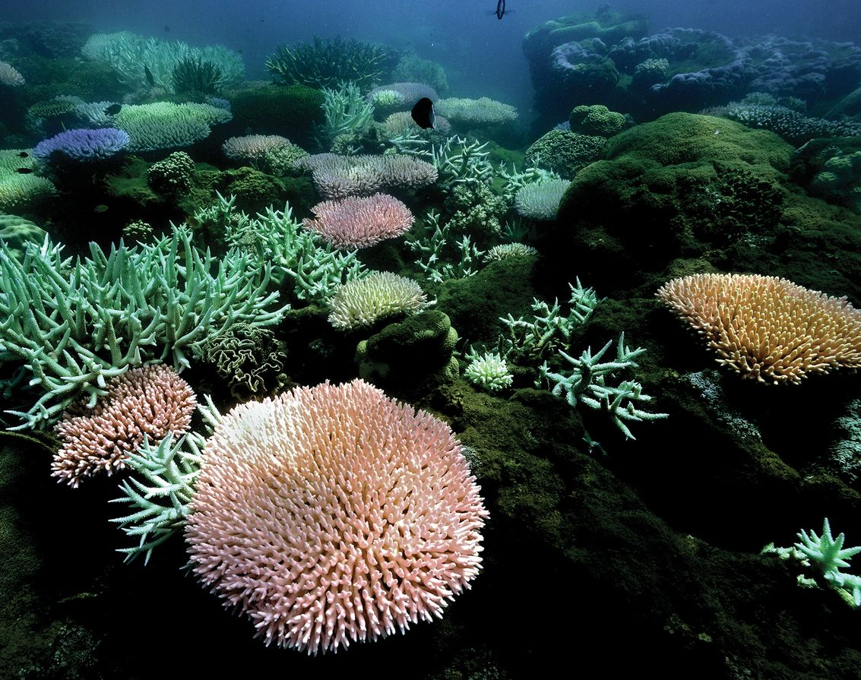
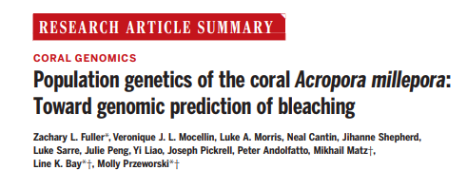
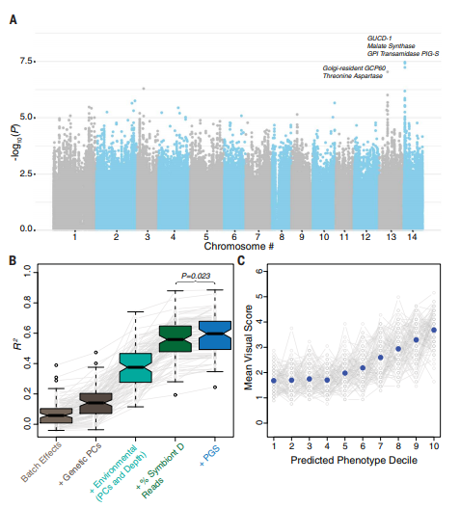
Notes:
https://science.sciencemag.org/content/sci/369/6501/eaba4674.full.pdf
A paper that does all three and with an applied goal.

Slide 10
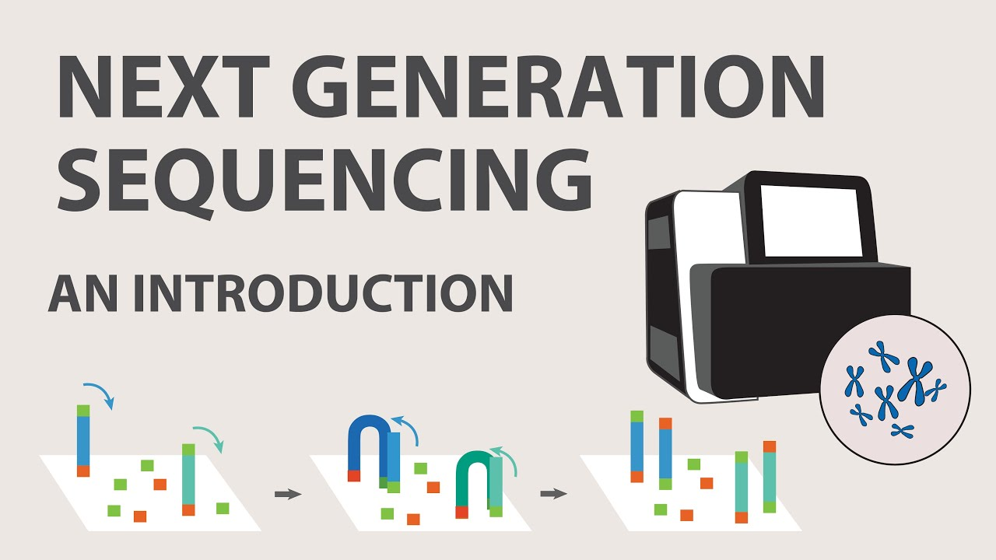
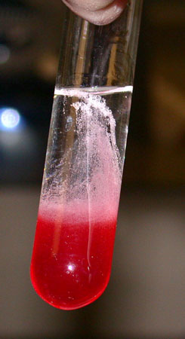
How do we do marine genomics?
Design experiment
Lab experiment
Field collection scheme
Download data
Perform analyses
Present results at conference
Publish paper
Extract DNA/RNA
https://www.youtube.com/watch?v=jFCD8Q6qSTM&ab_channel=AppliedBiologicalMaterials-abm
Notes:
All are interrelated. We will focus on performing analyses (which includes visualizing your data and doing statistical analyses)

Slide 11
We use bioinformatics to understand these questions
We’ll cover two main areas
The shell or Bash/UNIX
R
Many of these analyses are very computationally intensive
We will use a cloud computing resource called Jetstream

Slide 12
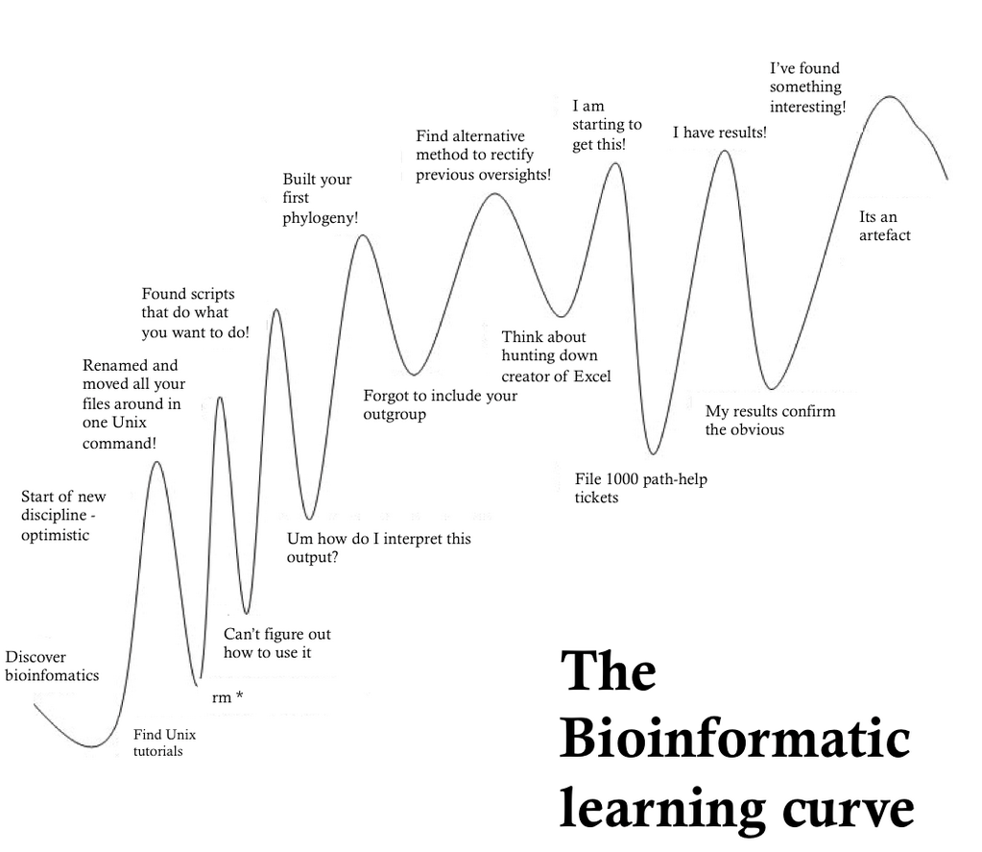
Source: https://images.app.goo.gl/9Z2yoRSwwNG9iNhu6

Slide 13
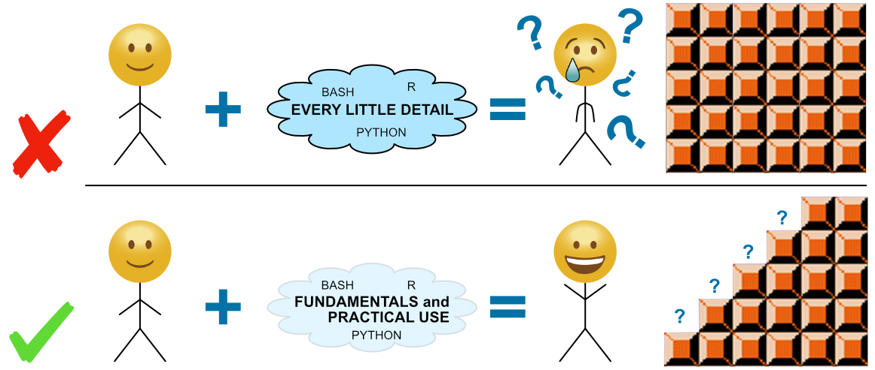
Source: https://www.google.com/url?sa=i&url=https%3A%2F%2Fastrobiomike.github.io%2Fabout%2F&psig=AOvVaw0RKmkNIIBkA5hP7oX73zI2&ust=1616086599613000&source=images&cd=vfe&ved=0CAIQjRxqFwoTCOCYxe_lt-8CFQAAAAAdAAAAABAX

Slide 14
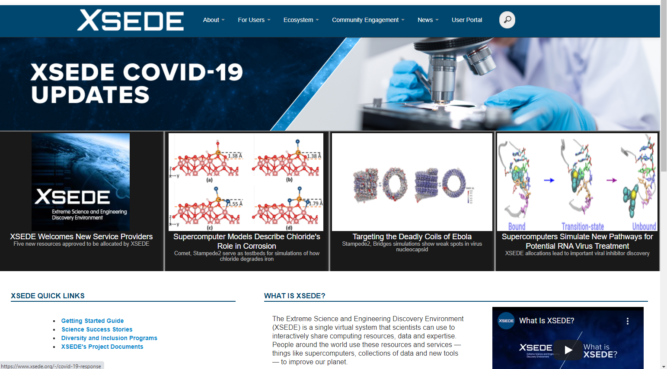
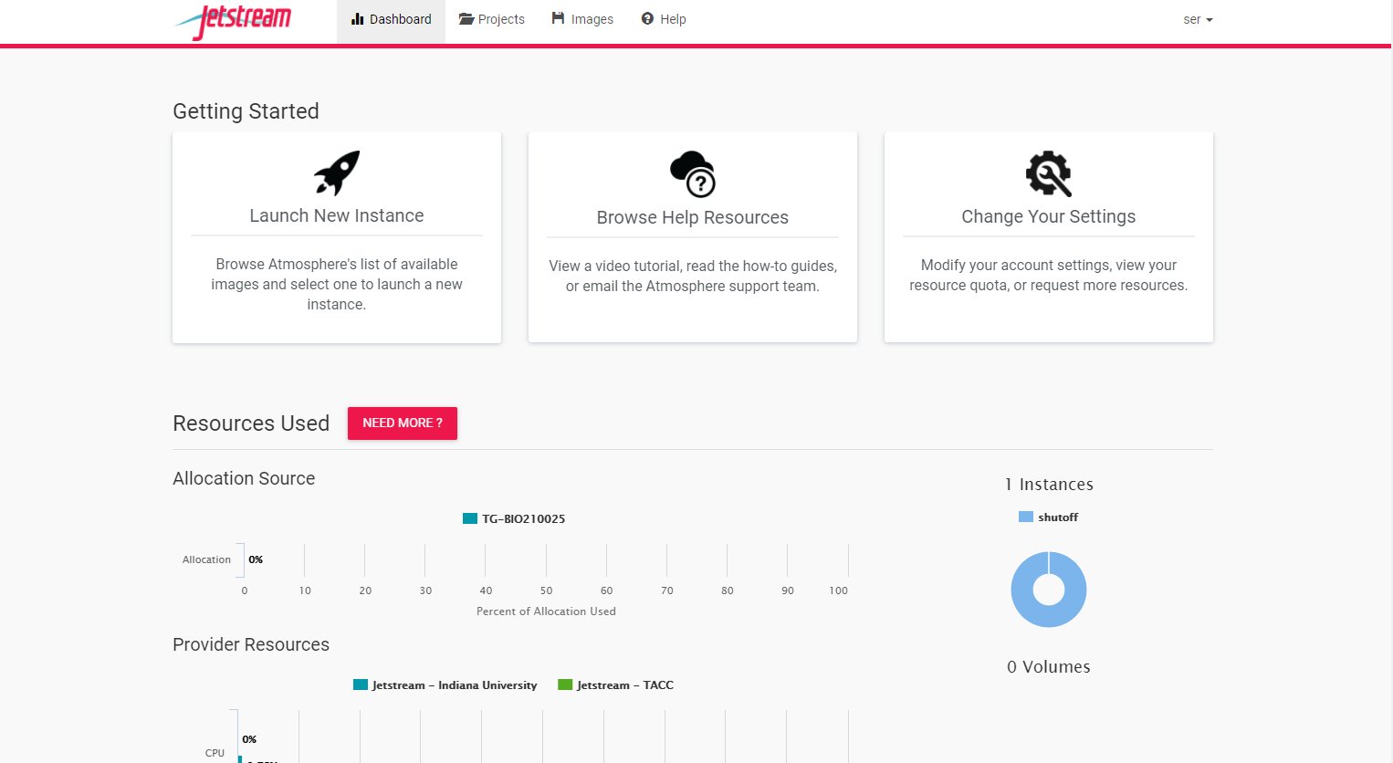
Jetstream via xsede
Notes:
Create an xsede account https://portal.xsede.org/my-xsede?p_p_id=58&p_p_lifecycle=0&p_p_state=maximized&p_p_mode=view&_58_struts_action=%2Flogin%2Fcreate_account

Slide 15
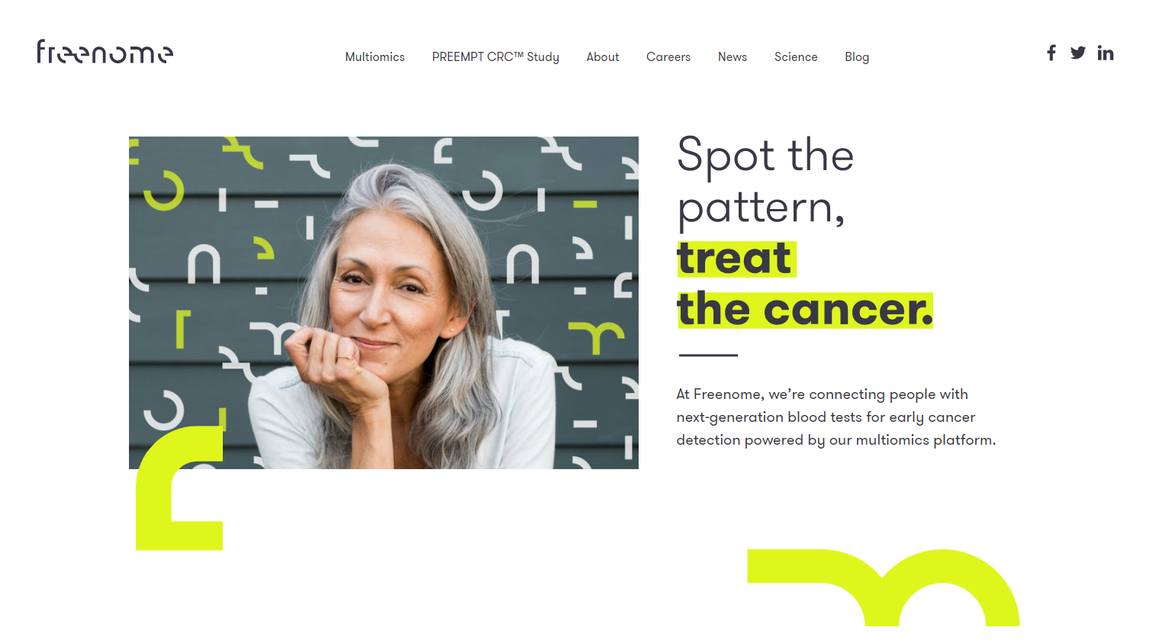


Why learn bioinformatics?
Gain many transferable skills!
Data science
Personalized medicine
NGO agency scientist
Undergraduate degree
Grad school
Postdoc
Professor
Research scientist in industry

